Slide 1
Texas Community Development Block Grant Program
New Features in TDA-GO!

Slide 2
TDA-GO Resources
Notes:
I’m going to refer you to this web page a lot today, as it’s often the first place we’ll send you if you call/email requesting technical assistance. Now, I’m not saying ALL the answers exist here, but I feel confident that most of the information you need to successfully understand TDA-GO’s functionality is located in this section of the Implementation Manual webpage. We update this section regularly and are always adding more “how-to” guides and resources that may be helpful in learning the system.

Slide 3
Definitions
Organization
User
Role
Document
Notes:
Let’s start off by defining some TDA-GO jargon you’re bound to hear during today’s webinar and any time you reach out for technical assistance:
An “Organization” is just like real life – it’s the organization, firm, agency, etc. that you work for and get paid by. A City or County would be an organization. So would a consultant firm, like Awesome Administrators, Inc. Even TDA has an organizational profile in the system. And while certain Organizations are eligible to apply for TxCDBG programs, it’s really the Users associated with the organization that will complete the application document and submit information in TDA-GO. All Users belong to an Organization.
Segueing into our next definition, a User is a TDA-GO account associated with a specific person, not role/position. So just like how a city will have many individuals fill the role of mayor over a few decades time, each new Mayor would have their own TDA-GO user account. So, for many communities that are experiencing leadership transitions as a result of recent elections, newly elected/appointed personnel should create a new User account within the existing organization.
Next, each user is assigned at least one Role within their organization. The assigned role determines what permissions and access that individual has. Roles can also be assigned specific to a document (we’ll get into this in a few slides). We’ve got a great resource on our website that describes each role in the system and their role-based permissions in each status a document moves through.
“Document” is a broad descriptor that includes applications (or the parent document that is home to the Grant Agreement and Grants Overview page, if awarded), performance reports (ENV, ACQ, GPA, GPB), materials and service reports (MSRs), payment requests, organizational compliance (OC), etc. Documents belong to a specific Organization.

Slide 4
Adding Users to Documents
Prerequisite: User must be registered in system.
Add User in My Organization
Add User from Outside Organization
Notes:
Now that we’ve got that our of our “system” (haha)… let’s chat about these new features!
This first one has been a needed upgrade to the system, and it’s finally here! Now there is a new process for adding users to documents in TDA-GO.
First thing to preface before we begin, these instructions are for adding users that are already registered in the system. This will NOT work in adding persons who do not yet have a profile in TDA-GO. The steps to becoming a TDA-GO user is a separate process that must have occurred before we can add users to documents. Check out the “TDA-GO Reference Documents” section of the Implementation Manual webpage for How-To’s on learning and navigating the system.
Secondly, there are two distinct processes for adding users to documents: 1) adding users within your own organization (city staff, for example) and 2) adding users from outside organizations (like consultants, grant writers, etc). We’re going to walk through each one step-by-step.

Slide 5
Add User from MY Organization
Example, Texas has an application in progress.
Currently, the Mayor (AO) only has access to the document.
Jane Doe, the Grant Coordinator for the City of Example was added to the city’s organization in TDA-GO after the application was initiated.
How can Jane Doe get access to this document?
Notes:
Let’s cover how to add users from your own organization first.
In this scenario, the City of Example was interested in applying for the upcoming 2022 FAST application cycle. The mayor is the authorized official for the organization, and they logged into TDA-GO and initiated the application. Soon after, the City hired Jane Doe as the city’s grant coordinator and successfully added her as a user within the city’s organization in TDA-GO. However, when Jane logged in, she’s unable to see/access the city’s ongoing FAST application. Why?
TDA-GO automatically assigns Grant Applicant users (like the AO & PD roles, etc.) when the document is created. Who ever already belongs to the applicant organization gets added to the new application document. This automatic assignment only happens once; so, if users are added to the Grant Applicant’s organization after the document has been created, the system will not automatically add them to existing documents.
So… how can Jane Doe with the City of Example get access to this document?

Slide 6
Add User from MY Organization
Navigate to Document
In blue navigation menu, under Tools click Add/Edit People
Click “+”
Select Add User From MY Organization
Notes:
In our example, the Mayor is the only other user within the city’s organization. So these steps will be completed by the Mayor. Once they’ve logged in and navigated to their 2022 FAST application document, the Mayor find “add/edit people” within the blue navigation menu to the left. Once there, click the “+” sign to the right and select “Add user from MY organization” **
**quick disclosure, if you navigate to this section before next week, the drop-down menu will have slightly different language. This should be addressed by next week and will then be consistent with today’s presentation.

Slide 7
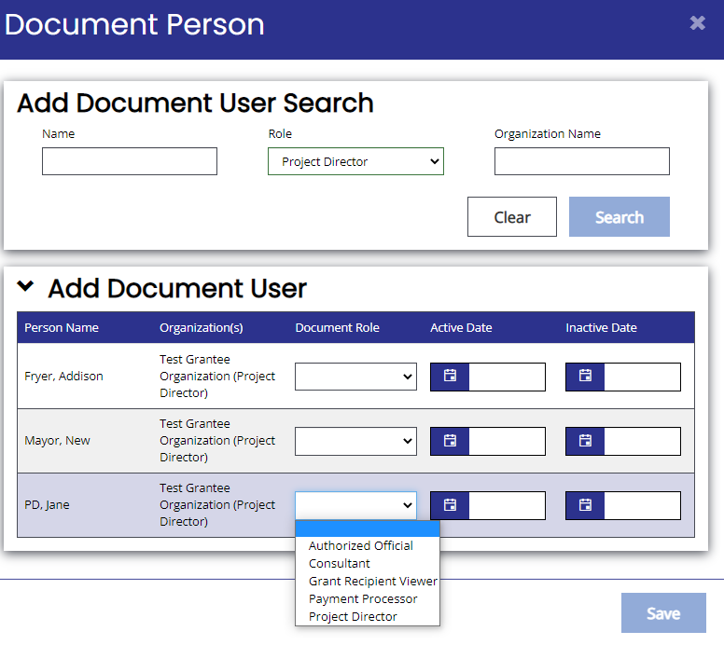
Add User from MY Organization
In Add Document User Search, search for user by Role or Name.
Select appropriate Document Role* from dropdown menu.
Click Save
*Document Role should mirror the role listed in parenthesis next to Organization.
Notes:
Then the “Add Document User Search” will pop-up. Search for user by Role or Name. So the Mayor might type “Jane” into the name field, or select “Project Director” under role field. Click enter and check out the results. Find the correct user and select the appropriate document role from the drop-down menu.** Click Save, and you’re done!
Let’s talk about Document Role for a minute… Document role just sets the permissions that each user will have in a specific document. So, while Jane Doe is a PD within the Organization, the system doesn’t automatically decide her Document Role when we use this process to add users to a document. Therefore, when manually adding users to a document make sure the role selected mirrors the role listed in parenthesis.

Slide 8
Add Users from OTHER Organization
Example, Texas has an
application in progress.
Currently, the Mayor (AO) and Jane Doe (PD) have access to the document.
The City recently selected Awesome Administrators, Inc. to provide administrative services and assist with application prep.
How can staff from Awesome Administrators, Inc. get access to this document?
Notes:
Switching gears, how do we add users to a document from an outside organization?
Back to our scenario: Now, the Mayor and Jane Doe have access to the city’s 2022 FAST application document. The city recently selected a grant administrator to assist with application prep and administrative services, if funded. Since Awesome Administrators, Inc. is a separate Organization in TDA-GO, their users do not belong to the City’s organizational profile (which is a good thing). How can staff from Awesome Administrators get access to the document?

Slide 9
Add Users from OTHER Organization
Navigate to Document
In blue navigation menu, under Tools click Add/Edit People
Click “+”
Select Invite User From Other Organization
Notes:
Remembering that both the Mayor and Jane Doe have access to this document, either person could complete these steps. Once successfully navigated to the document, again find “add/edit people” in the blue navigation menu. Click the “+” sign to the right and select “Invite user from Other Organization” **
** again, same disclaimer as before… slightly different language in drop-down menu until next week’s update.

Slide 10
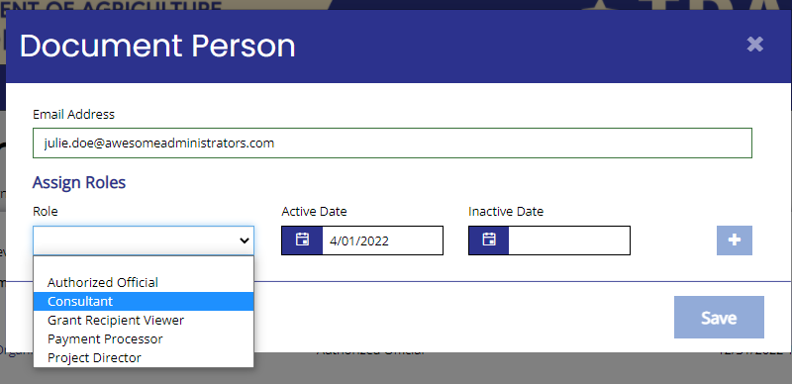
Add Users from OTHER Organization
Enter email address of user to be invited*
Select appropriate Role** from dropdown menu.
Click Save
*Email address MUST match email associated with consultant user’s TDA-GO account or this will not work.
**Only Consultant or Grant Recipient Viewer roles may be selected. Failure to select appropriate role may result in disallowed costs or revocation of Admin Certification.
Notes:
Then, this window will pop up on the screen. Enter the email address of the outside user to be invited and select the appropriate role from the dropdown menu. Click “Save” and the city’s part is done!
Couple key points:
The email address MUST match the email associated with the outside user’s TDA-GO account or the invite will not work. So consultant staff, make sure to communicate the correct email address clearly to your clients when requesting to be invited.
Only select “Consultant” or “Grant Recipient Viewer” as the role assigned to an invited, outside user. The Consultant role has the ability to add/edit/save certain fields within the document, while the GR view role is a View-Only role and does not have edit or save permissions in any fields. Failure to select an appropriate role may result in the disallowed costs or revocation of Admin Certification…So yes, we’re serious about this!
Same conflict-of-interest warning as always: Do not add outside users to a document until they have been formally selected to provide professional services for this project. Doing so would result in an apparent conflict of interest, which would prohibit the consultant from “competing” for the services contract (if awarded).

Slide 11
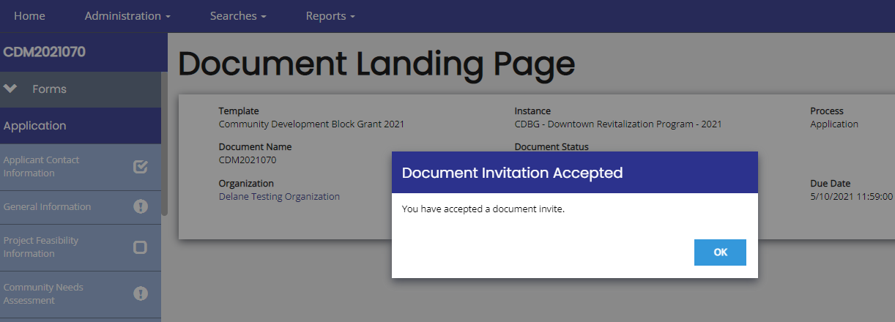
Add Users from OTHER Organization
Julie Doe from Awesome Administrators, Inc. will receive an email with a link to accept the invite to be added to the document.
Clicking on the link will prompt the user to sign into TDA-GO. Once signed in, the system will open the document and display this message
Notes:
And here’s what this process looks like for the outside user that’s been invited to the document.
In our example, the PD for the city completed the previous steps and invited Julie Doe from Awesome Administrators. Julie has since received a system generated email that looks like this. She will then click on the emailed link (which is only valid for 48 hours). The link will redirect to the login screen; once signed in, the system will open the document and display this message. And that’s it!

Slide 12
Add Users from OTHER Organization
At this point, the following users have access to the document:
Mayor (AO)
Jane Doe (PD)
Julie D. from Awesome Admin, Inc. (Consultant)
Now, Julie D’s coworker, John McTest, needs access to this document.
Awesome Admin, Inc. has subcontracted with Shantel Berry of Excellent ERRs, LLC, who also needs access to this document.
How can staff from Awesome Admin and Excellent ERRs get access to this document?
Notes:
Continuing with our scenario, now the Mayor, Jane Doe (PD), and Julie D their consultant have access to the document. The application is moving along nicely, however a couple elements of the document will be completed by Julie’s coworker John McTest who also works at Awesome Admin. Additionally, Julie’s firm has subcontracted with Excellent ERRs.
How do we add additional outside users from Awesome Admin and Excellent ERRs to this document?

Slide 13
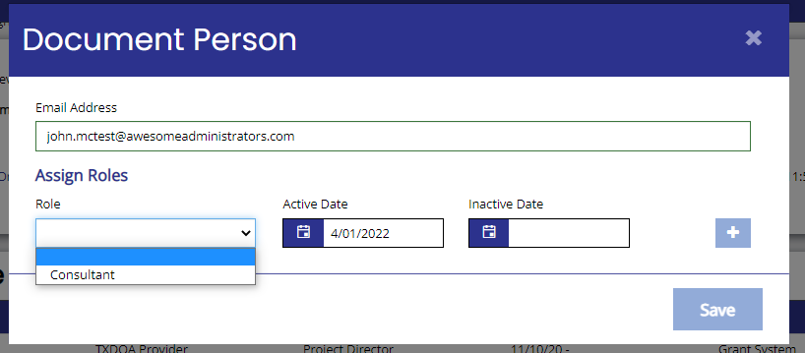
Add Users from OTHER Organization
Follow steps for Adding Users from OTHER Organization.
This can be completed by any user assigned to the document.
Now that Julie D. has access to the document, she can follow these same steps to invite her coworker John McTest and Shantel Berry from Excellent ERRs.
Notes:
Simple answer – same steps as we previously discussed. But now, this process can be completed by any user assigned to the document. This means that since Julie D from Awesome Administrators has access to the document, she can follow these same steps to invite her coworker John McTest and Shantel Berry from Excellent ERRs.
You might notice that Julie only has one Role selection, which makes this an easier process. Consultants should only be able to add other outside users as consultant roles.

Slide 14
Troubleshooting
“Invite link is not valid” message
Email address entered does not match user
If so, retry invite with correct email address
Link has expired (older than 48hrs)
If so, retry invitation and accept promptly
Can’t find user to add when searching
Users outside organization will not appear in search results for adding user from “MY organization”
Go back to Add/Edit People and select “Add User from OTHER Organization”
You may not have appropriate credentials to add user. For example, PD users do not have permissions to add AOs to documents (this feature mirrors permissions for user set up).
Request staff from org with appropriate permissions complete this step; or
Request help from TDA Staff by submitting Support Ticket
Notes:
Inevitably, there will be hiccups in this process and we’re here to help. However, let’s try a few things first:
[read]

Slide 15
Support Ticket Form
“Locked out” of TDA-GO due to exceeding login attempts
New AO and previous AO user no longer with organization
Request general technical assistance for TDA-GO functionality
Link located in TDA-GO section of Implementation Manual web page.
Notes:
The next feature isn’t exactly within TDA-GO, so much as an update to how to request technical assistance for those issues that just need a human. As much as we genuinely LOVE to hear from you via call/email, unless it’s an absolute crisis… you’ll get a more expedient solution to your TDA-GO functionality issues by using this new process. This is where the new Support Ticket Form comes into play!
Here’s what it’s for:
User locked out of system – the system will tell you when you’ve exceeded your login attempts
General technical assistance on how to navigate the system
When unexpected leadership changes prevent new/current employees from accessing documents in TDA-GO

Slide 16
Coming Soon!
Document Messages
Notes:
Coming soon! Document Messages is currently live in the system HOWEVER, we are still working on final touches before this feature is fully functional and used by TDA staff. In theory, this feature will be the communication repository for all two-way correspondence related to this document. Each document (both parents and sub-docs) have a document repository…

Slide 17
Coming Soon!
Notes:
And what’s especially exciting, is that this tool is pretty powerful. Same concept as “Notes” where each document has it’s own Notes section, or in this case, Document Messages. But what’s different and *awesome* is that the message search feature will find correspondence associated with the parent or sub/related documents. NEAT! Like I said, this feature’s design isn’t 100% complete yet but you might begin to receive some messages via this tool as we continue testing and improving. Stay tuned as we’ll be sure to walk through the final product.

Slide 18
Questions?
Link to Support Ticket Form HERE
Notes:
And that’s it for me! What questions do you have?

